Slide 1
Water4Otter
Check for Understanding
Lesson 1

Slide 2
Question #1:
Where does our water come from?

Slide 3
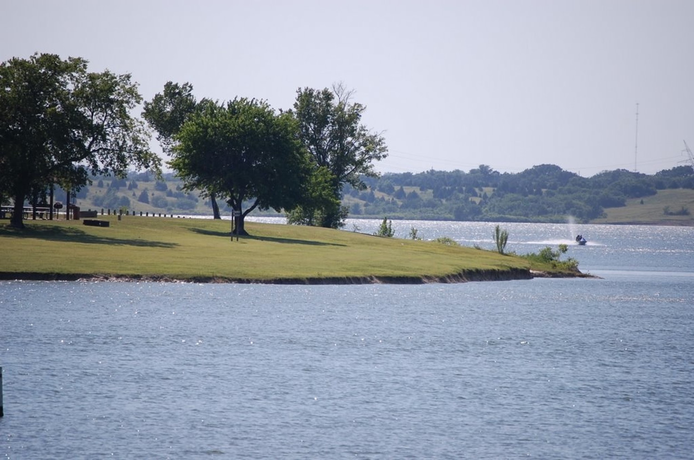
Question #1:
Where does our water come from?

Slide 4
Question #1:
Where does our water come from?
Answer:
Lavon Lake

Slide 5
Question #2:
What is a drought?

Slide 6
Question #2:
What is a drought?
A long period of time with no rain
A dark grey color
A person in a bad mood
A time of day

Slide 7
Question #2:
What is a drought?
A long period of time with no rain
A dark grey color
A person in a bad mood
A time of day

Slide 8
Question #3:
Where do we use the most water?

Slide 9
Question #3:
Where do we use the most water?
OR
Outside
Inside

Slide 10
Question #3:
Where do we use the most water?
OR
Outside
Inside
Answer:
Outside

Slide 11
Great job!

